Slide 1
Flow of Agricultural Nitrogen version 3: Loss of agricultural Nitrogen by NO and N₂O
Jinmu Luo
Committee members: Peter Hess, Christine Goodale, Natalie Mahowald
June 30, 2023
Notes:
Hi, Thank you for being here today, it’s my honor to have you in my academic committee. It has been ten months since I came here last year, and I’ve really learned a lot from you in class and research. And today, I’m glad to share some of my research progresses with you, and I hope I can hear some feedback and any suggestions; Then introduce the topic.

Slide 2
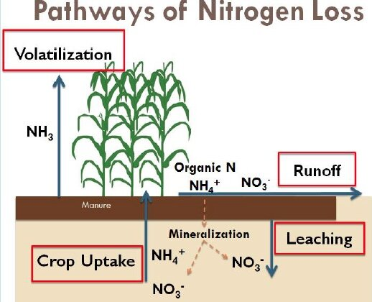
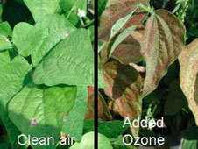
Introduction
NO, N₂O emission is an important way of agricultural nitrogen loss.
NO emissions produce O₃, and O₃ can damage plants (>40 ppb).
N₂O is the third most important greenhouse gas.
Statistical and regression model has limited ability to project future NO emission.
Notes:
Figure 1 : https://phys.org/news/2019-04-manure-application-winter-crop-nitrogen.html
Figure 2 : https://www.nasa.gov/topics/earth/features/soybeans.html

Slide 3











FANv3
FANv2
Fertilization
NO, N₂O
Fertilization
NH₃
NO, N₂O
Canopy
Capture
Surface Runoff
TAN (NH₄⁺)
NO₃⁻
N₂
FAN (2cm)
Fixation and Deposition
Nitrification
Denitrification
Upward diffusion
Downward diffusion
Sub-surface Runoff
Nitrification
Denitrification
NH₄⁺
NO₃⁻
N₂
Uptake
CLM
Immobilization
Mineralization
Litter
Soil Organic
Decomposition
Notes:
(1) Your works; (2) how to use FAN to form a whole nitrogen cycle; (3) How biological processes control the nitrogen budge of different reactive nitrogen in soil, then it would influence the FAN.

Slide 4
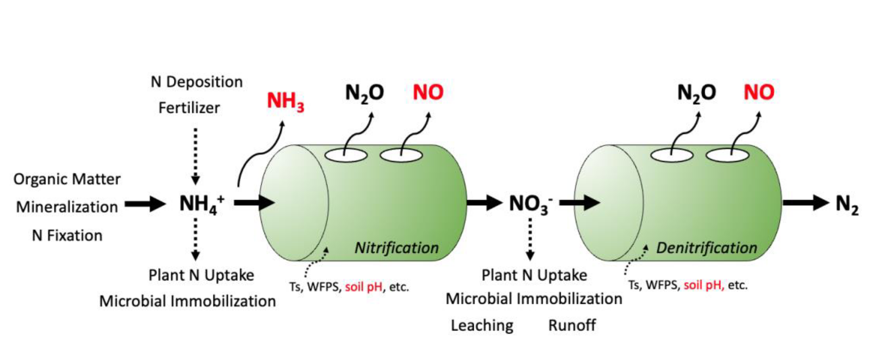
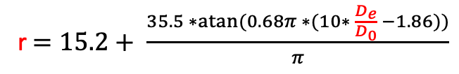
Some backgrounds
Hole-in-the-pipe model
r$=15.2+ \frac{35.5 ∗atan⁡(0.68π ∗(10∗ \frac{D_{e}}{D_{0}} −1.86))}{π}$
= r * N₂O
= r * N₂O
Parton et al ., 2001; Van Martin et al., 2023
Notes:
(1) FANv2 provides the NH4 (2) this model is very old, but very classical, it considers some environmental scalars like water content, ph and temperature, that’s the best we can find now (3) what control the NO emission.

Slide 5
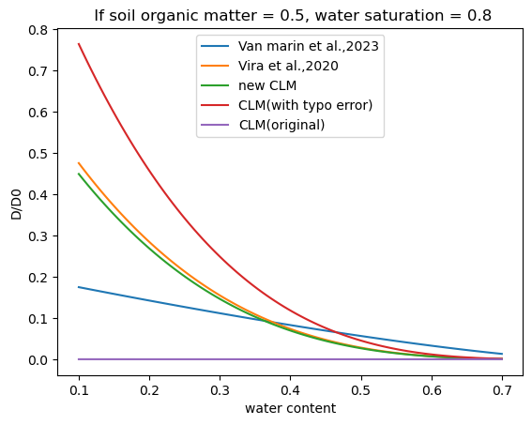
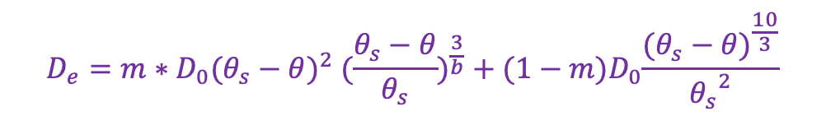
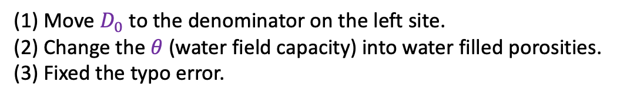
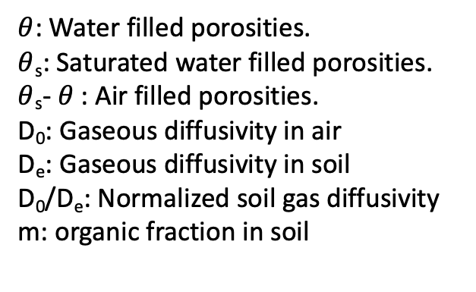
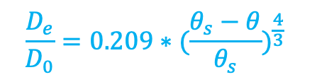
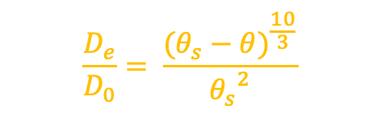
Soil gas diffusivity (Normalized soil gas diffusivity, tortuosity)
$$D_{e}=m∗D_{0}{(θ_{s}−θ)}^{2} ({\frac{θ_{s}−θ}{θ_{s}})}^{\frac{3}{b}}+{(1−m)D}_{0}\frac{{(θ_{s}−θ)}^{\frac{10}{3}}}{{θ_{s}}^{2}}$$
$$\frac{D_{e}}{D_{0}}= \frac{{(θ_{s}−θ)}^{\frac{10}{3}}}{{θ_{s}}^{2}}$$
$$\frac{D_{e}}{D_{0}}=0.209∗({\frac{θ_{s}−θ}{θ_{s}})}^{\frac{4}{3}}$$
$θ$: Water filled porosities.
$θ$_{s}: Saturated water filled porosities.
$θ$_{s}- $θ$ : Air filled porosities.
D₀: Gaseous diffusivity in air
D_{e}: Gaseous diffusivity in soil
D₀/D_{e}: Normalized soil gas diffusivity
m: organic fraction in soil
(1) Move $D_{0}$ to the denominator on the left site.
(2) Change the $θ$ (water field capacity) into water filled porosities.
(3) Fixed the typo error.
More N to N₂O in denitrification, N₂O emission: 6.8 Tg to 8.9 Tg
A reasonable NO to N₂O ratio.

Slide 6
Some updates
After correction of the diffusion problems in CLM and incorporated the land use change schemes into FAN, we now have a stable version.
2000-2017 simulation, 1.9 x 2.5, CLM with Crop and BGC on.
Results average over 2010 ~ 2015, with 2000-2009 at spin-up
Tg/yr |  | NO |  | N₂O |  | N₂
 |  | Nitrification | Denitrification | Nitrification | Denitrification | Denitrification
CLM | Agr | 1.5072 | 2.8065 | 1.9860 | 4.3870 | 101.0120
 | Nat | 2.7060 | 3.5819 | 2.2540 | 3.9853
FANv3 | Agr | 0.8906 | 0.0002 | 0.6890 | 0.0002 | 0.0146
 | Nat | 0.8065 | 0.0006 | 0.4542 | 0.0006
SUM |  | 5.9103 | 6.3892 | 5.3832 | 8.3730 | 101.0266
Canopy reduction of NO: Agricultural land (11%); Natural forest (22%)

Slide 7
TgN/yr | NO |  |  | N₂O |  |  | Notes
 | Agr | Nat | Agr + Nat | Agr | Nat | Agr + Nat
FANv3 + CLM 5.0 | 5.2 | 7.1 | 12.3 | 7.1 | 6.7 | 13.8 | This study, 2010 - 2015
CLM 5.0 (default) | 1.1 | 0.7 | 1.8 | 4.7 | 2.9 | 7.6 | 2010
Van Martin et al., 2023 | 2.17 |  |  | 3.12 |  |  | CLM 5.0, 2010-2014
Harris et al .,2022 |  |  | 13.7 |  |  | 12.6 | Isotope, box model, 2010
Weng et al., 2020 |  | 9 ~ 10 | 9 ~ 10 |  |  |  | GEOS-Chem, 1980-2017
Jaegle et al., 2004 | 2.5 - 4.5 | 5.4 | 8.9 |  |  |  | GOME satellite, 2000
Vinken et al., 2014 |  |  | 12.9 |  |  |  | GEOS-Chem, OMI, 2005
Tian et al ., 2020 |  |  |  | 2.5 ~ 5.8 | 4.9 ~ 6.5 | 7.4~12.3 | Muti-model comparisons
Hudman et al., 2012 | 1.8 | 7.2 | 9.0 |  |  |  | Mechanic model, OMI, 2006

Slide 8
NH₃: 57.19
NO: 1.59
N₂O: 1.02
N₂: 0.01
Runoff: 17.01
Fertilization: 209.8
FAN
N Loss: 76.84
Unit: TgN
Year: 2017
Diffusion:
56.06
Diffusion:
252.63
Harvest and fire:
76.62
Fixation:
79.40
Denitrification:
102.83
NO: 5.45
N₂O: 7.26
N₂: 88.77
Diffusion:
176.19
Plants
Deposition:
18.46
Uptake:
881.00
Uptake:
106.59
Soil NH₄⁺
Litter
Soil NO₃⁻
Immobilization:
1768.79
Immobilization:
1.6
Leaching:
5.92
Soil organic matter
Mineralization:
2698.29
Runoff:
24.32
Nitrification: 187.06
NO: 3.58
N₂O: 3.74
Notes:
(1) Introduce the nitrogen cycle; (2) how can we fine tune CLM to help more place the emission into right processes.

Slide 9
NH₃: 57.19
NO: 1.59
N₂O: 1.02
N₂: 0.01
Runoff: 17.01
Fertilization: 209.8
FAN
N Loss: 76.84
Unit: TgN
Year: 2017
Diffusion:
56.06
Diffusion:
252.63
Harvest and fire:
76.62
Fixation:
79.40
Denitrification:
102.83
NO: 5.45
N₂O: 7.26
N₂: 88.77
Diffusion:
176.19
Plants
Deposition:
18.46
Uptake:
881.00
Uptake:
106.59
Soil NH₄⁺
Litter
Soil NO₃⁻
Immobilization:
1768.79
Immobilization:
1.6
Leaching:
5.92
1 -2 order small
Soil organic matter
Mineralization:
2698.29
20 %?
Runoff:
24.32
Nitrification: 187.06
NO: 3.58
N₂O: 3.74

Slide 10
Summary of Nitrogen cycle (with FUN)
N add, Tg/yr
Manure | Fertilizers | Fixation | Deposition | Total
123.4 | 86.4 | 79.4 | 18.5 | 307.7
N loss, Tg/yr
NH₃ | NO | N₂O | N₂ | Runoff | Harvest | Fire | Total
57.19 | 10.6 | 12.0 | 88.8 | 47.3 | 32.5 | 44.1 | 292.49
Notes:
Talk about the total balance; structures.

Slide 11
Agricultural Soil
Manure | Fertilizers | Fixation | Deposition | Total
56.42 | 86.44 | 7.36 | 2.98 | 153.20
N add, Tg/yr
NH₃ | NO | N₂O | N₂ | Runoff | Harvest | Fire | Total
42.58 | 4.92 | 6.65 | 40.14 | 29.59 | 11.09 | 3.27 | 138.24
N loss, Tg/yr
Natural Soil
Manure | Fertilizers | Fixation | Deposition | Total
66.99 | 0 | 72.03 | 14.96 | 153.95
N add, Tg/yr
NH₃ | NO | N₂O | N₂ | Runoff | Harvest | Fire | Total
14.61 | 5.71 | 5.38 | 48.63 | 17.68 | 21.45 | 40.81 | 154.27
N loss, Tg/yr

Slide 12
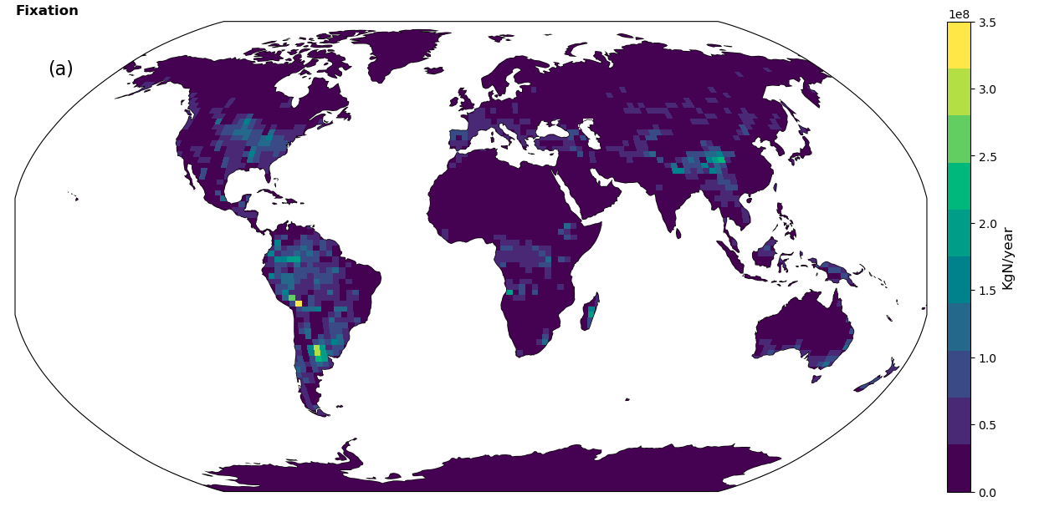
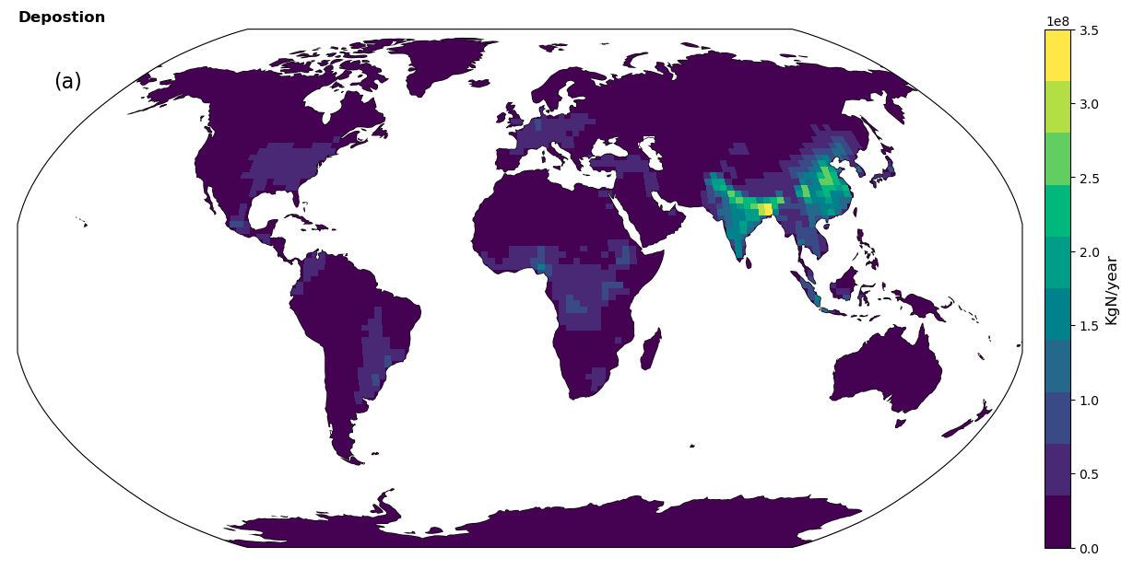
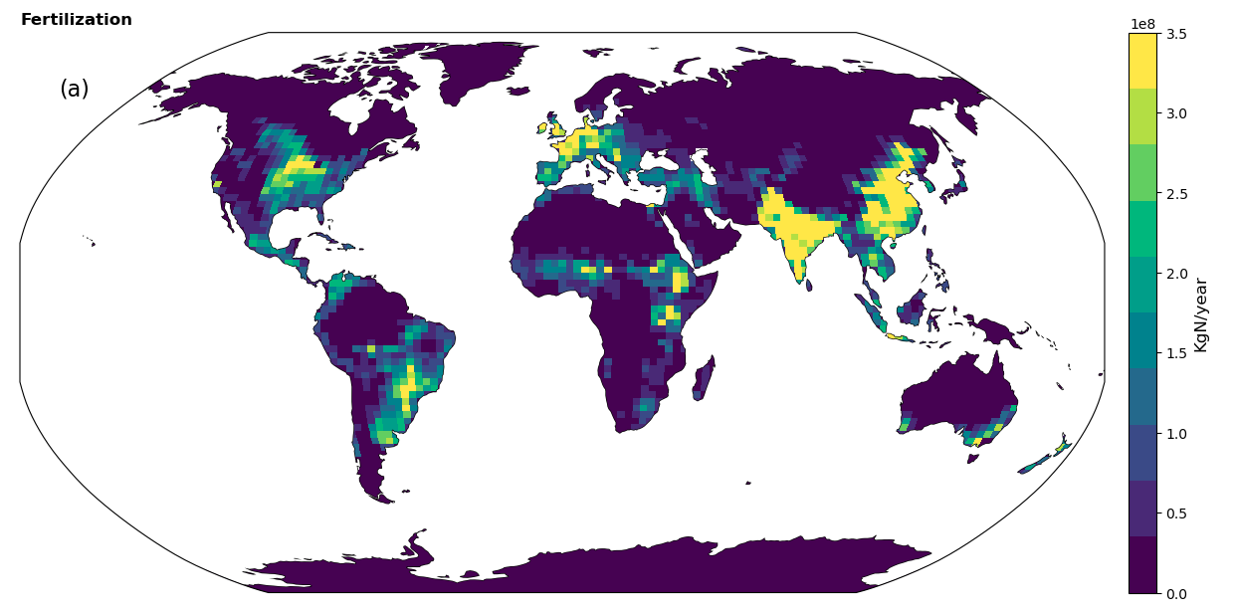
Fixation
Deposition
Fertilization

Slide 13
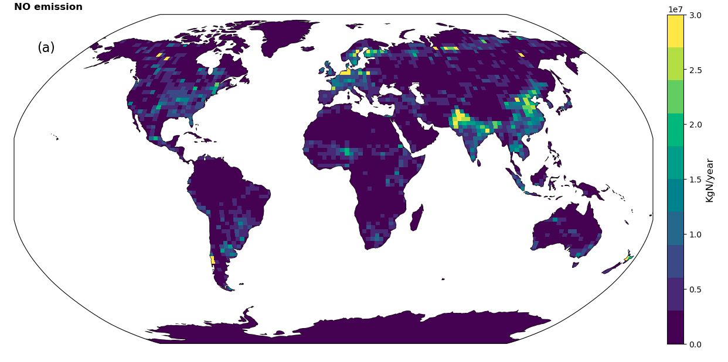
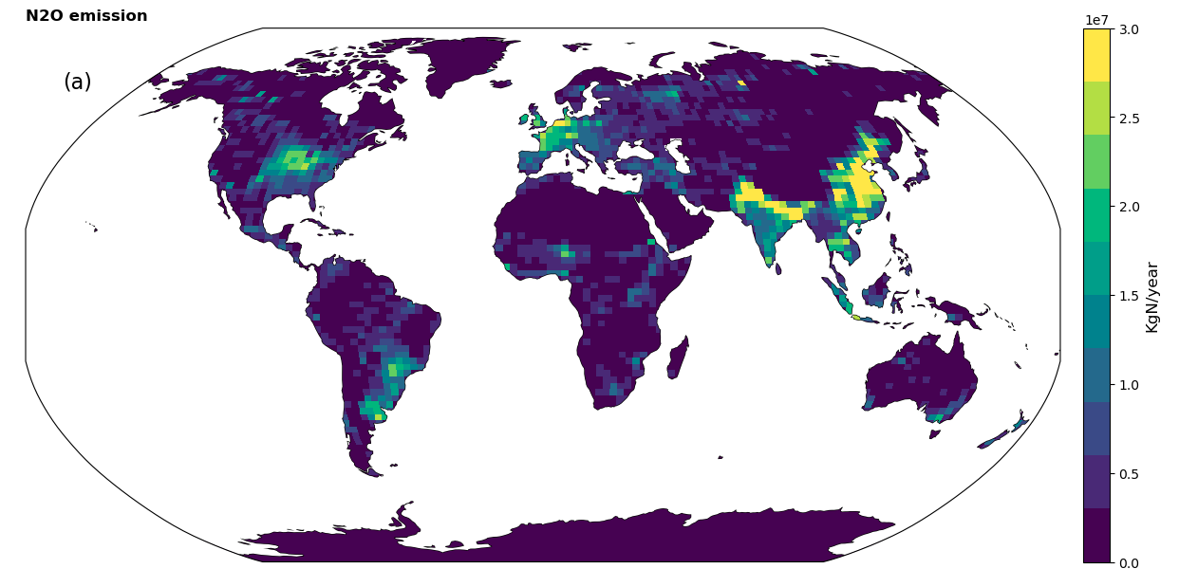
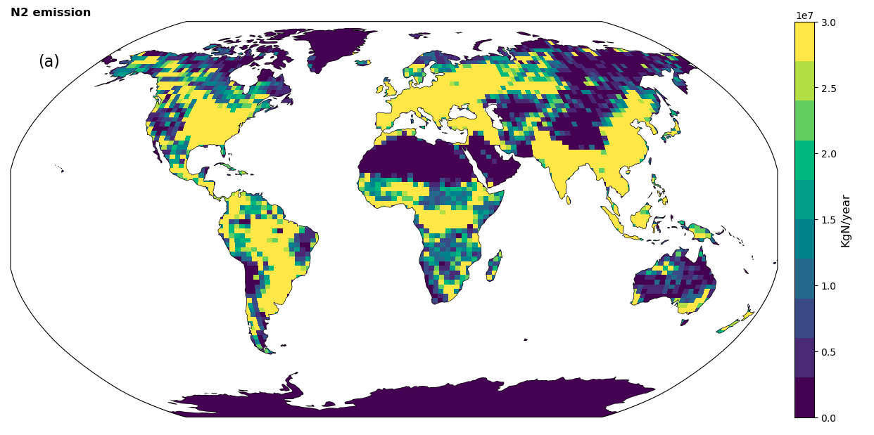
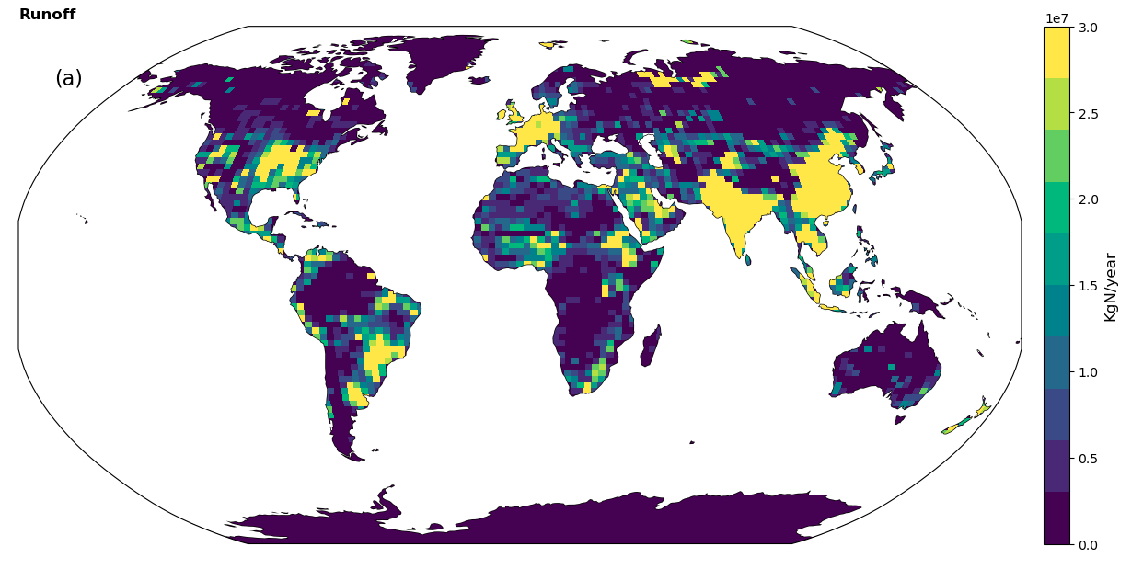
NO emission
N₂O Emission
N₂ Emission
Runoff

Slide 14
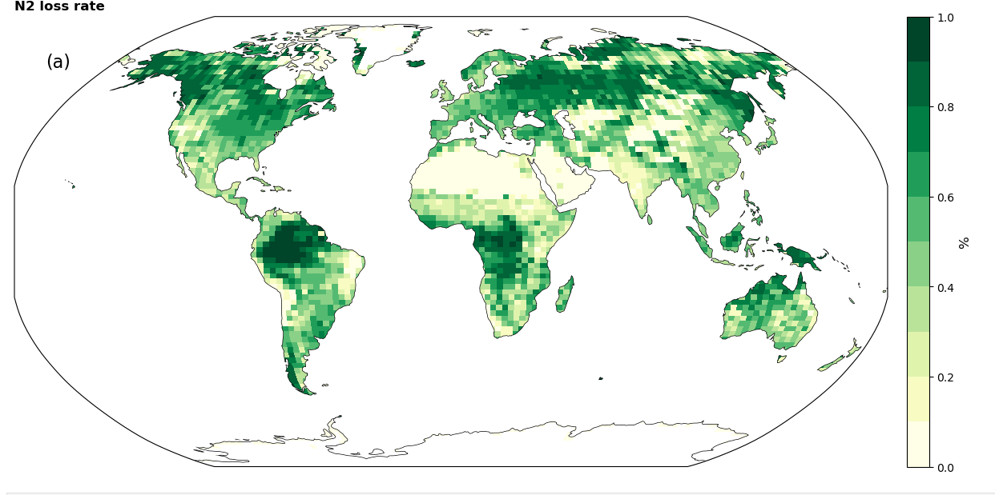
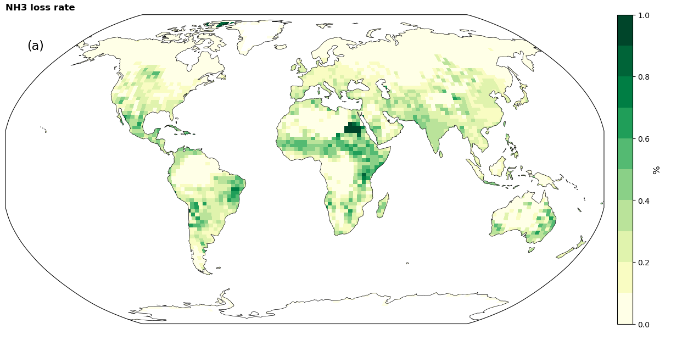
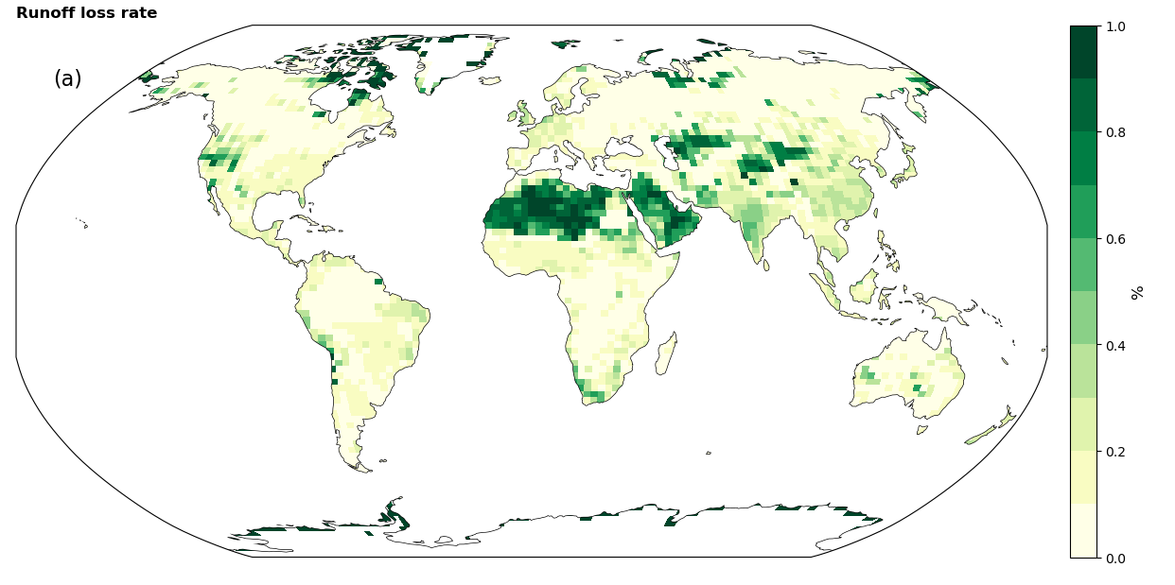
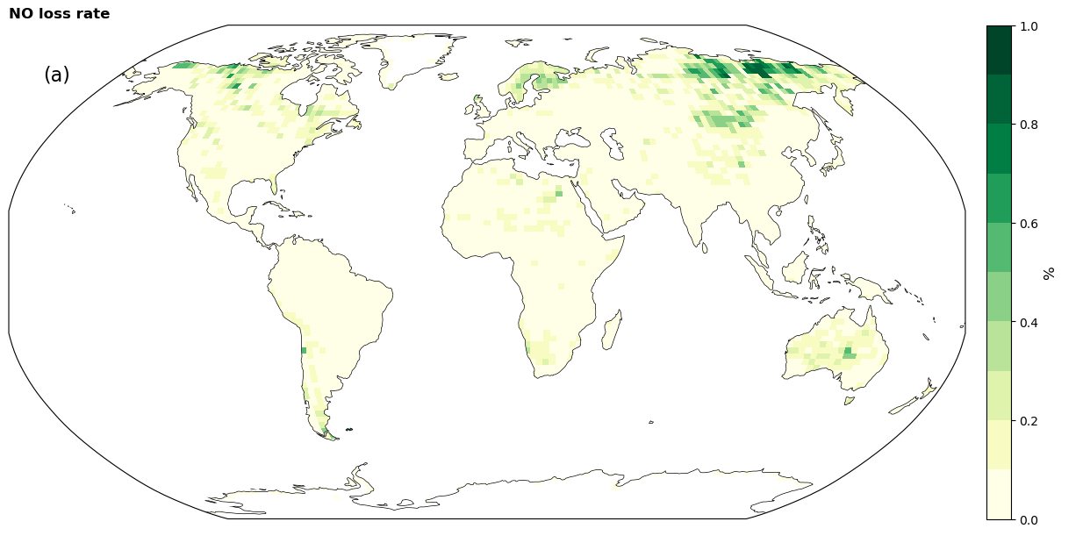
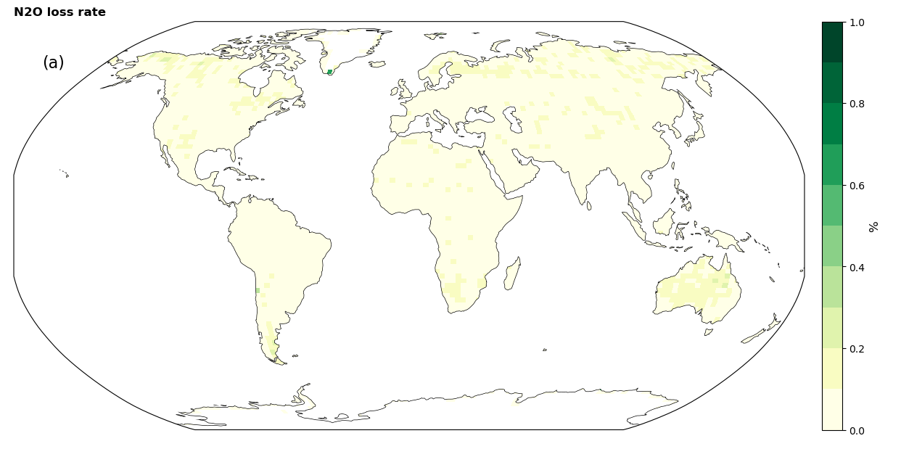
Loss rate
NH₃
N₂
N₂O
Runoff
NO
Notes:
N2 dominates the overall N loss, but NH3 loss in Africa play a important role.

Slide 15
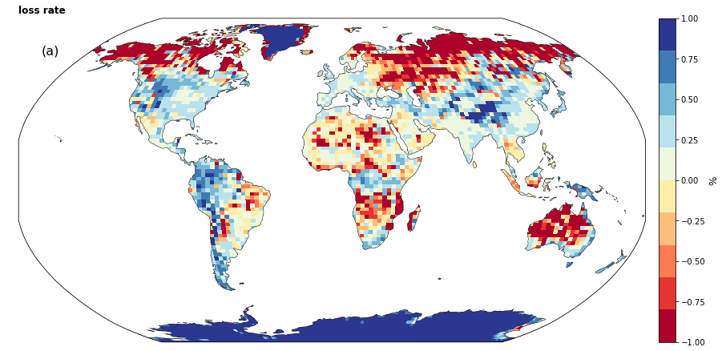
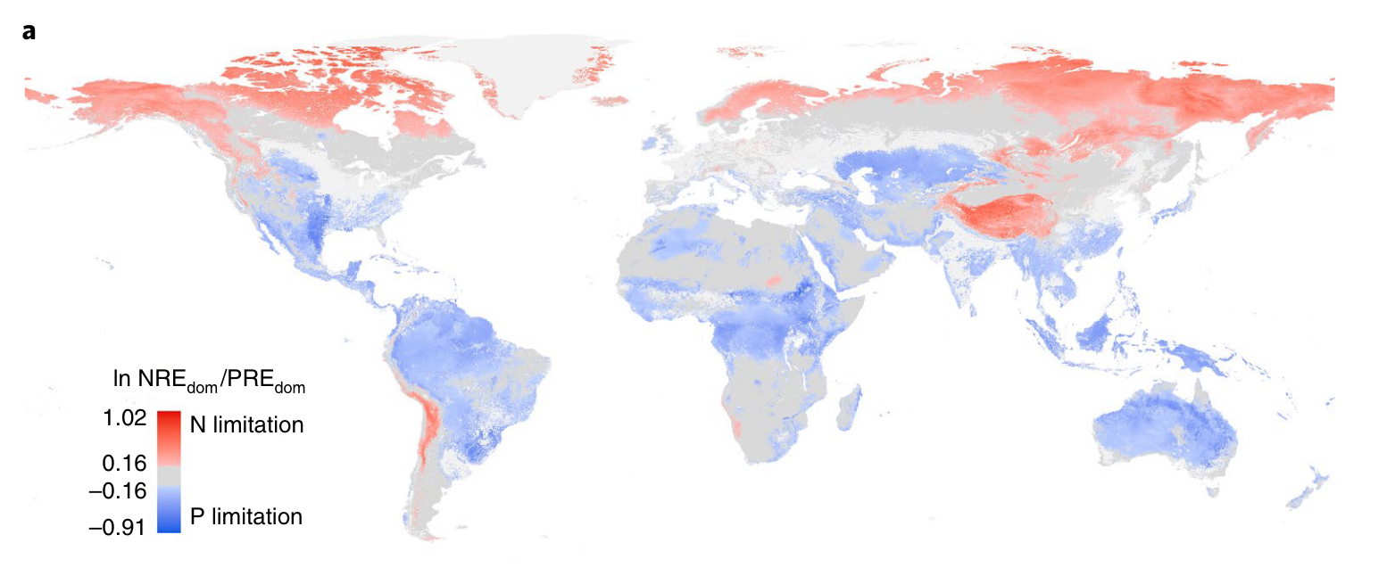
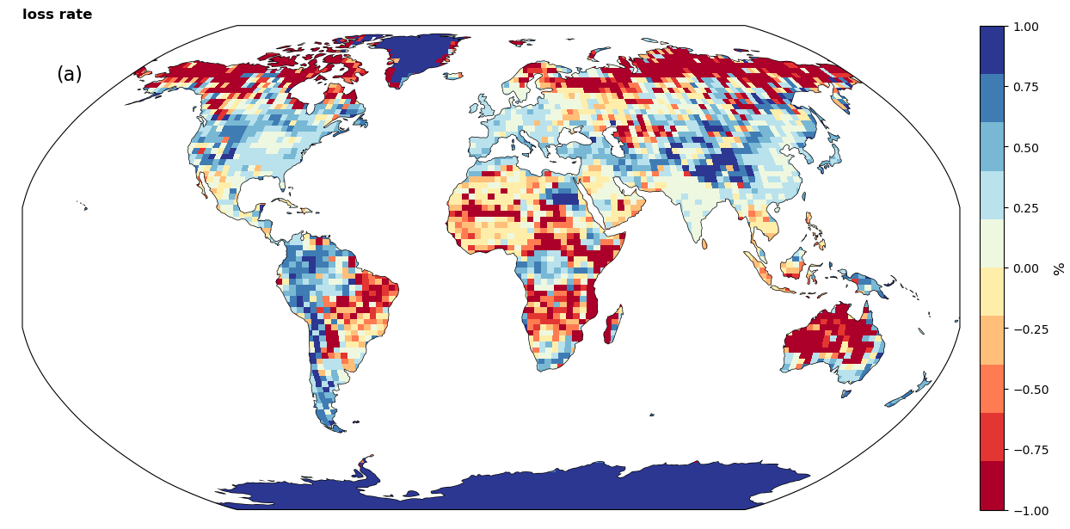
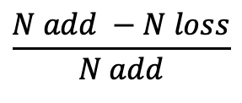
$$\frac{N add −N loss}{N add}$$
Gas N loss in the boreal forest regions causes the Nitrogen limitation?
N, P limitation
FANv3
2010-2017
Du et al., 2020
CLM Default
2010-2017
Notes:
https://www.nature.com/articles/s41561-019-0530-4

Slide 16
$$\frac{N add −N loss}{N add}$$
Gas N loss in the boreal forest regions causes the Nitrogen limitation?
N, P limitation
FANv3
2010-2017
Du et al., 2020
CLM Default
2010-2017
Notes:
https://www.nature.com/articles/s41561-019-0530-4

Slide 17
Summary
FANv3 development, coupled FANv3 with CLM
Corrected Diffusion in CLM to produce ‘realistic emissions’
Implemented conservative land use change scheme into FAN.
Reactive N emission dominated by NH₃ (not simulated in most models)
Most of NO comes from denitrification (53%).
Likely too much N₂O from nitrification (39%).

Slide 18
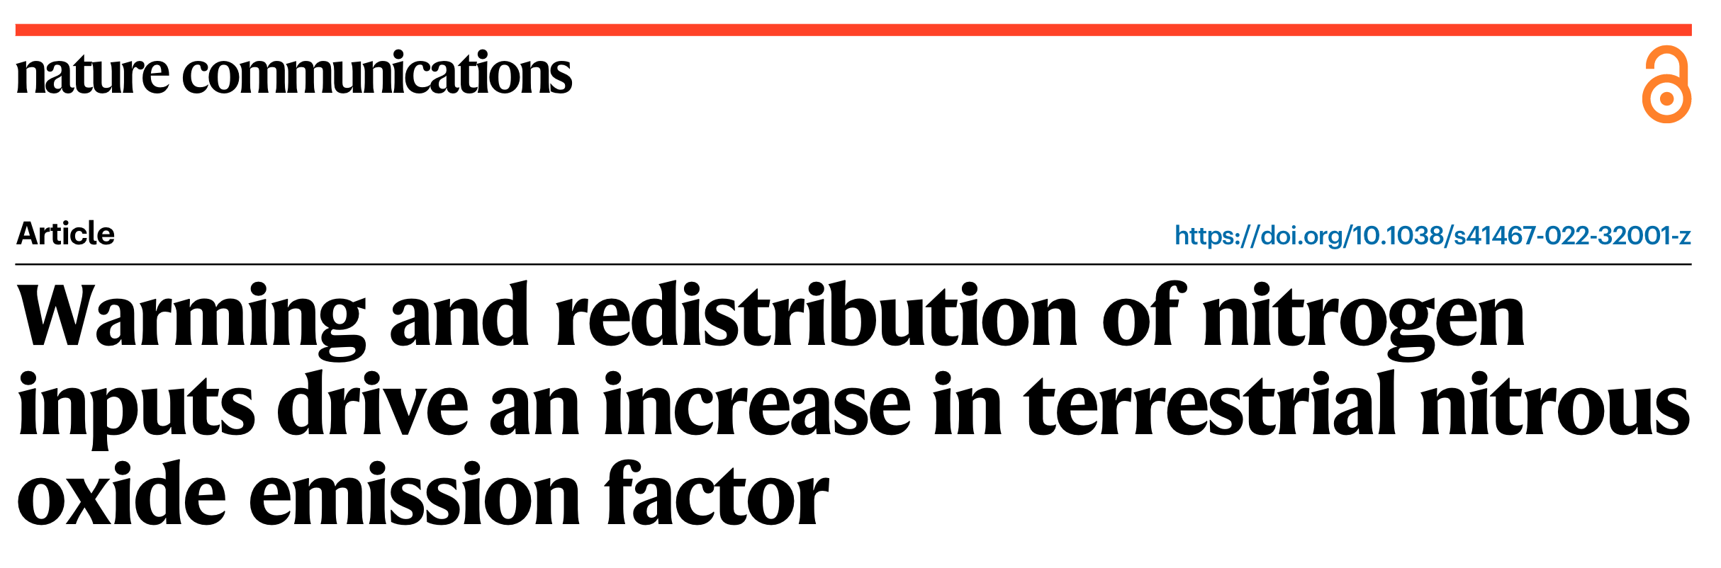
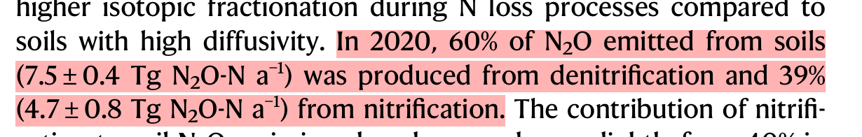
Summary
Most of NO comes from denitrification (53%).
Likely too much N₂O from nitrification (39%).

Slide 19
Issues
Fine-tune CLM
Force the NO and N2O emissions into the right processes.
Plant uptake of NH₄⁺ and NO₃⁻
NO₃⁻ immobilization rate.

Slide 20
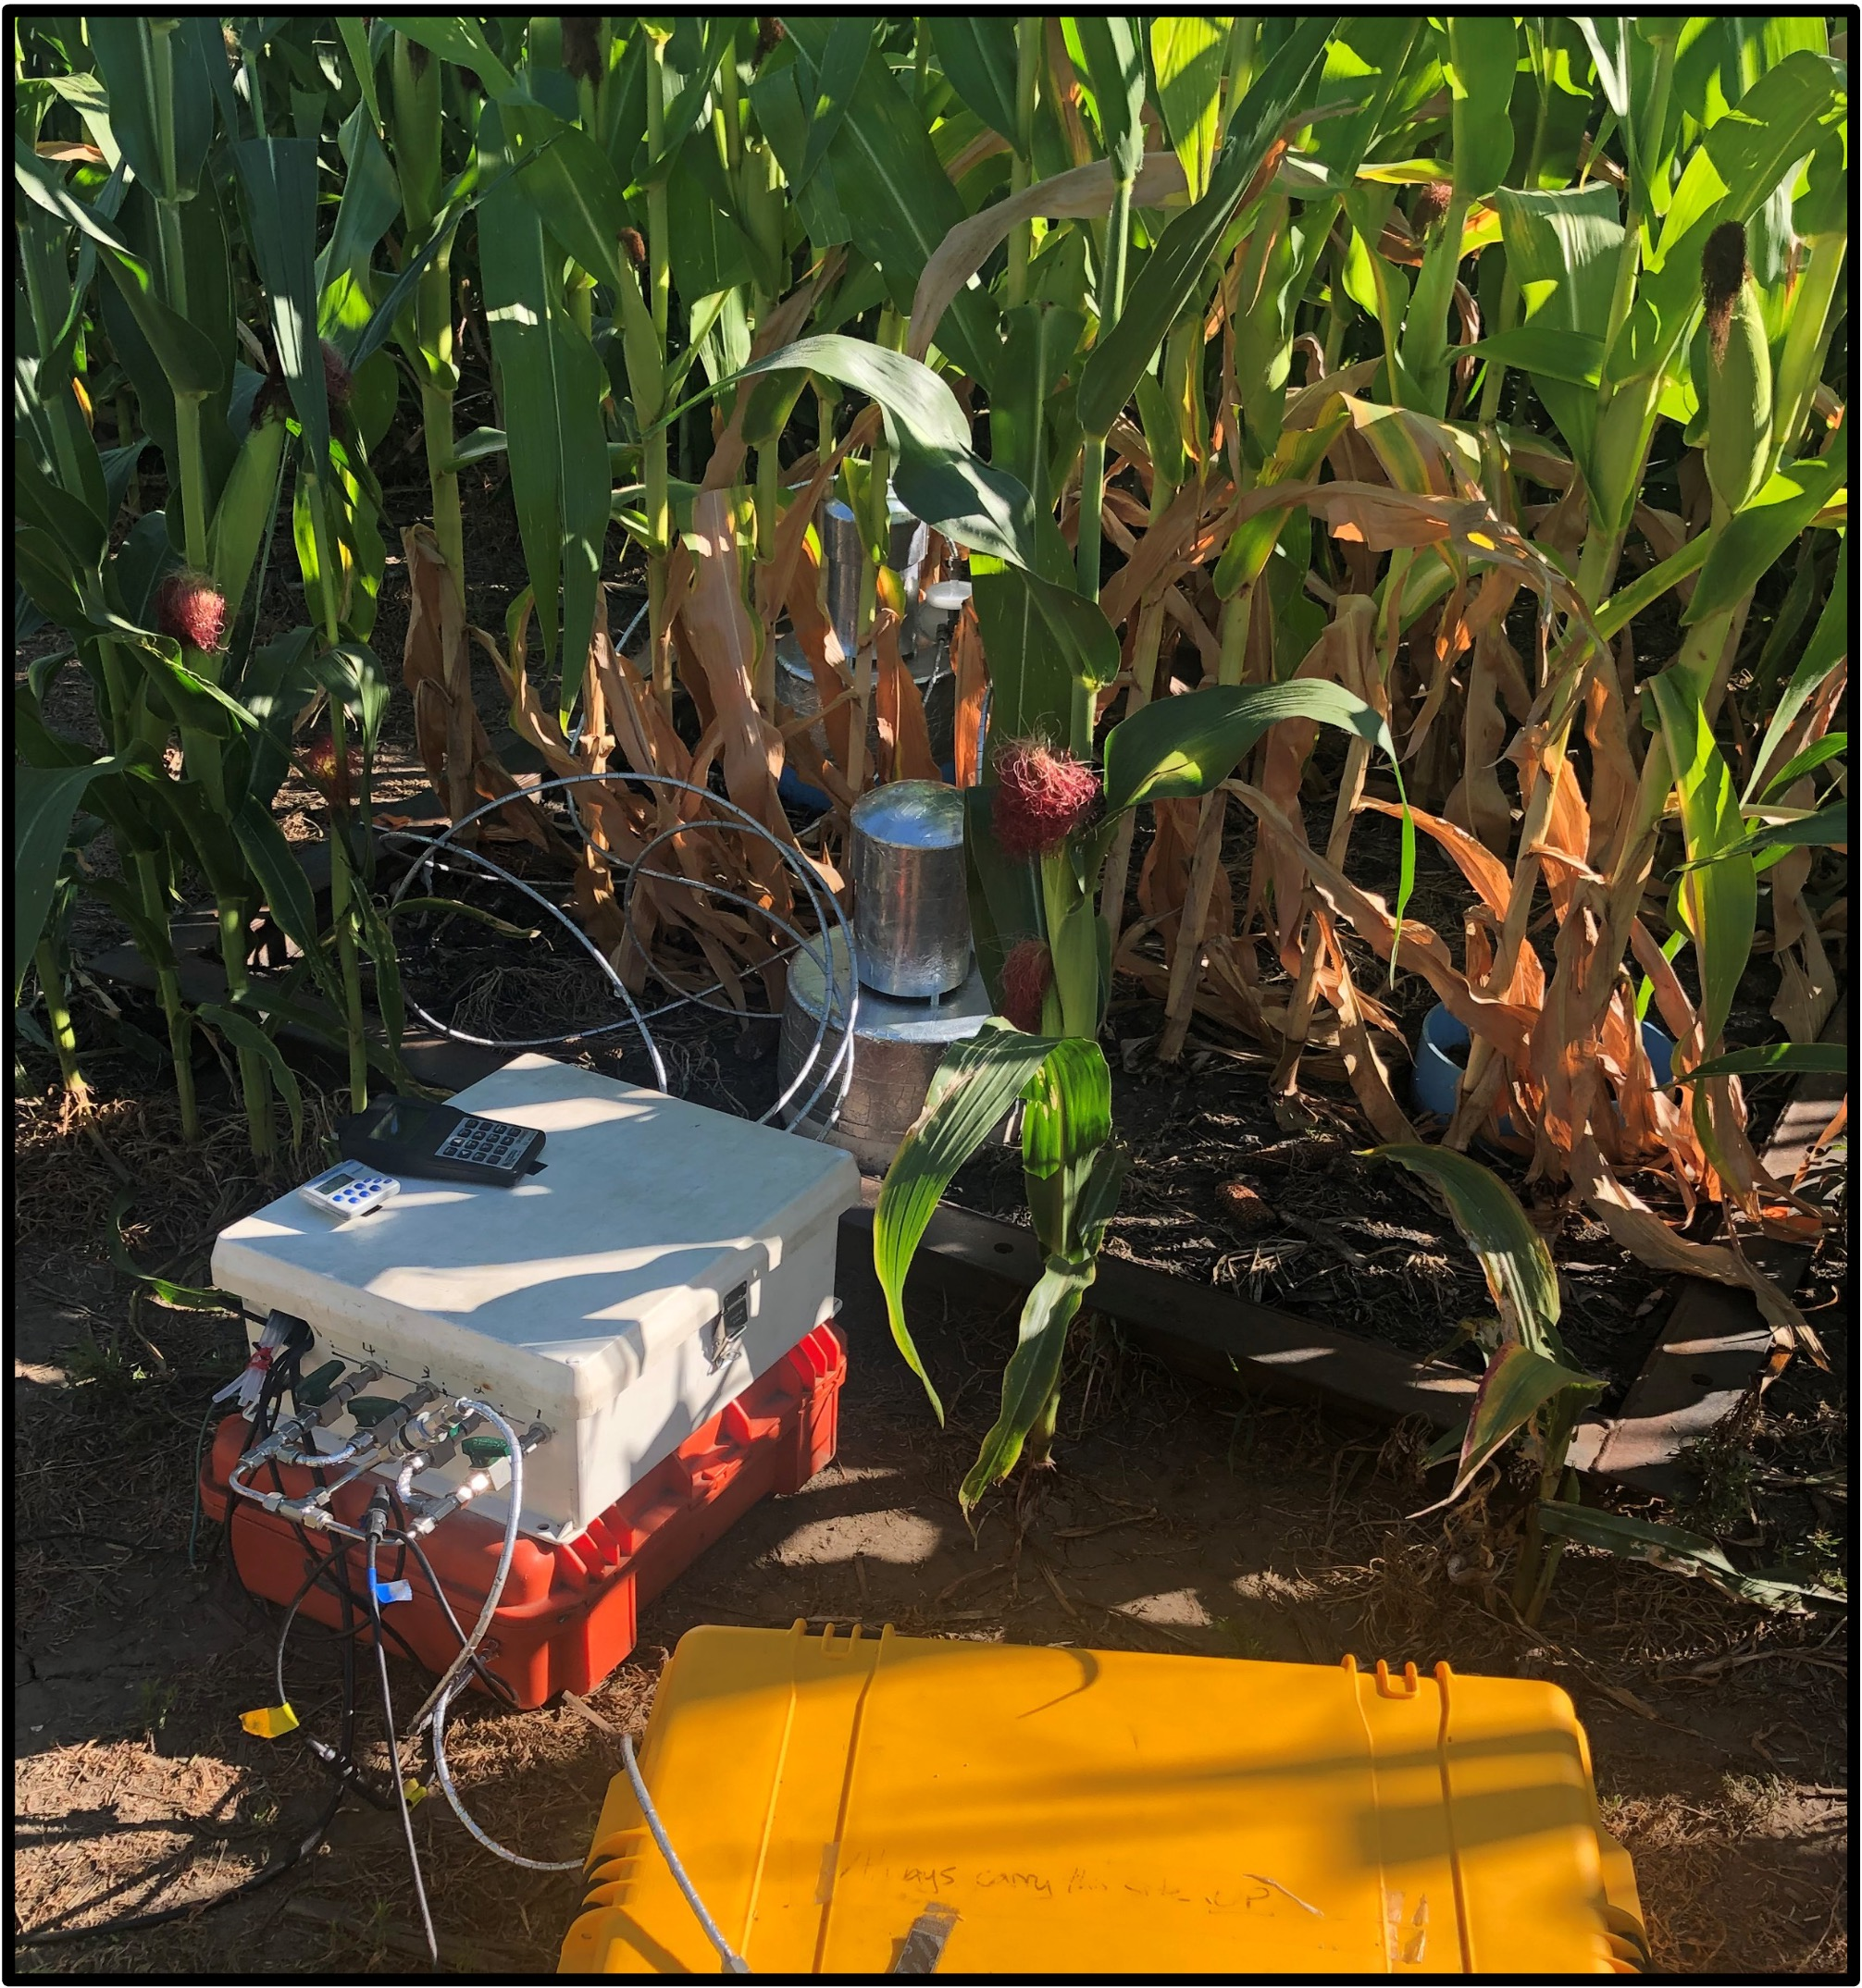
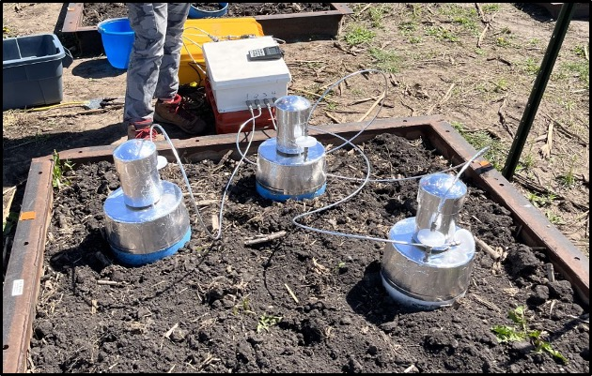
Next: Evaluate budget against mesocosm measurements (Steven Hall, ISU)
Soil water, temperature measurements.
Fertilization, NO, N₂O, leaching, crop uptake.
What parameters to tune?
Notes:
CLM single site simulation.

Slide 21
Next
More interactions between CLM and FAN.
Nitrogen deposition goes through FAN first; Canopy capture of NH₃.
Test different climate scenarios to project future emissions.
Couple with CAM, O₃ simulation, and crop destruction.

